Slide 1

SUPPORT 2 Dataset Overview
Coursework 2 by Group 1

Slide 2
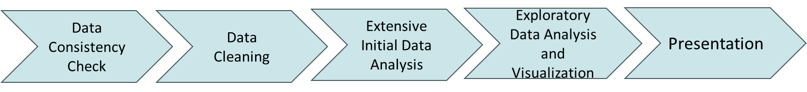
Objectives
Perform an initial data analysis and exploratory data analysis using Python to derive meaningful insights from the health dataset.
Purpose of the Dataset
To create and test a model that predicts 180-day survival for seriously ill hospitalized adults (Phase I of SUPPORT) and compare its accuracy with an existing system and doctors' own predictions (Phase II of SUPPORT).
Dataset Link: UCI Machine Learning Repository
Project Flow

Slide 3










Methodology and Technology
Notes:
All the pictures are from free internet resources.

Slide 4

Exploring and Cleaning the Dataset

Slide 5
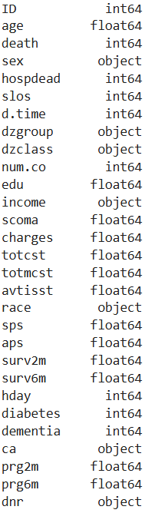
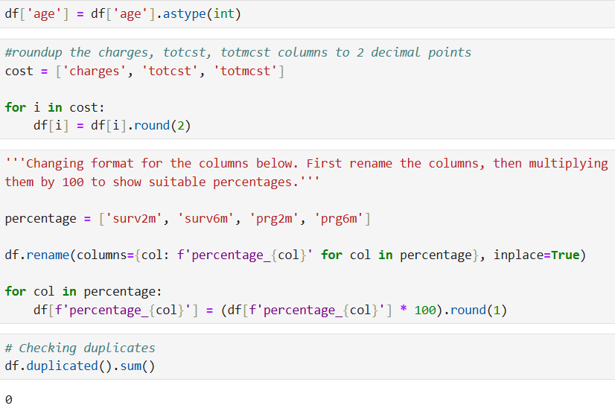
Checking and Formatting Data Types
Change the data type for 'age' column to integer number.
Round the columns with decimal numbers to two decimal places
Change the format for 'surv2m, surv6m, prg2m, and prg6m' columns. Since they represent the percentile, rename the column titles and present the percentage of them for better understanding of the values.

Slide 6
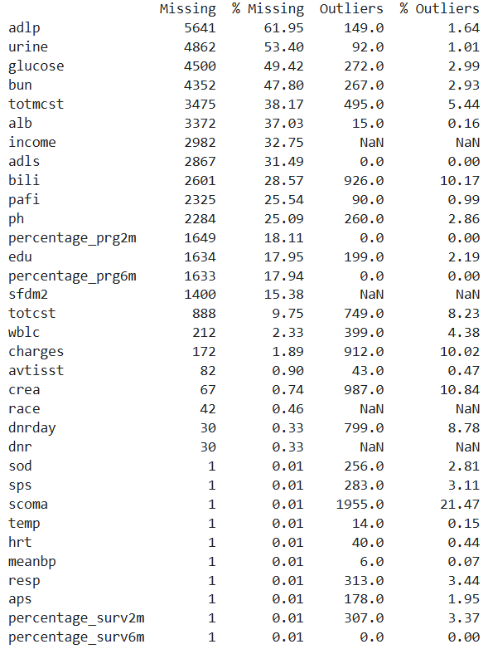

Checking Missing Values and Outliers

Slide 7
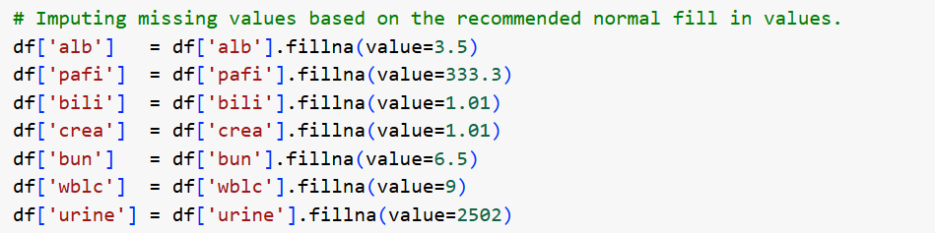

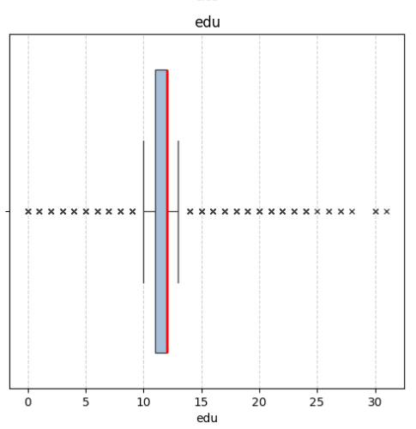
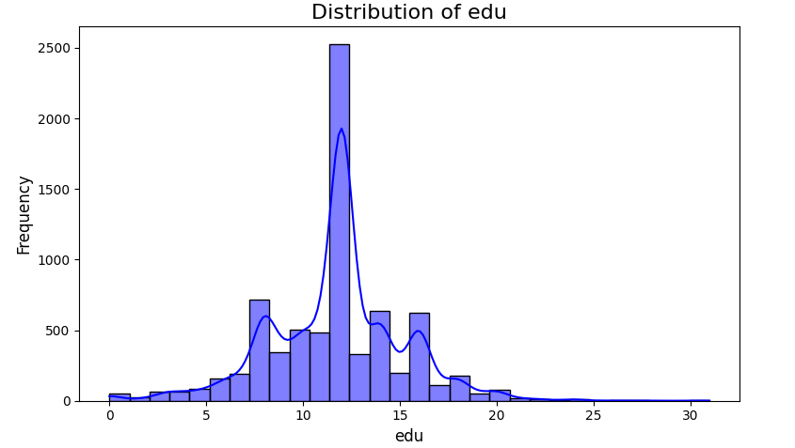
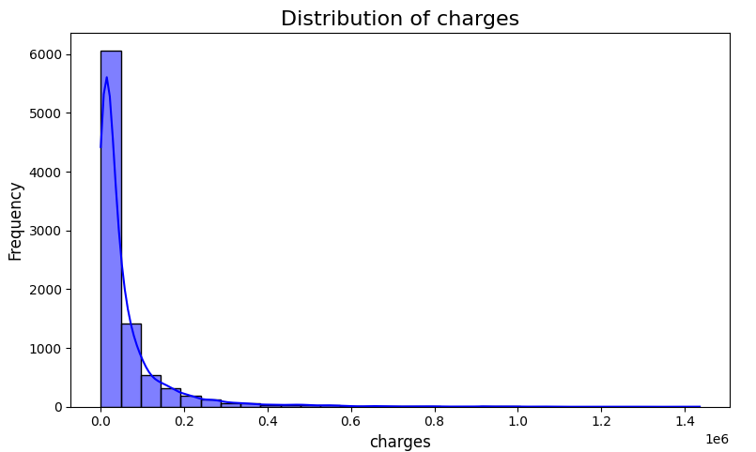


Handling Missing Values and Outliers

Slide 8
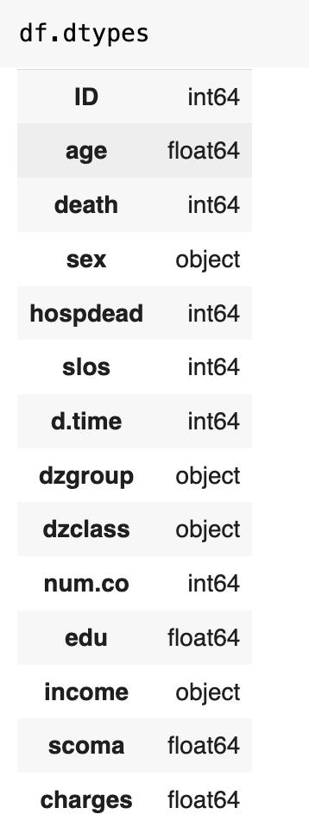
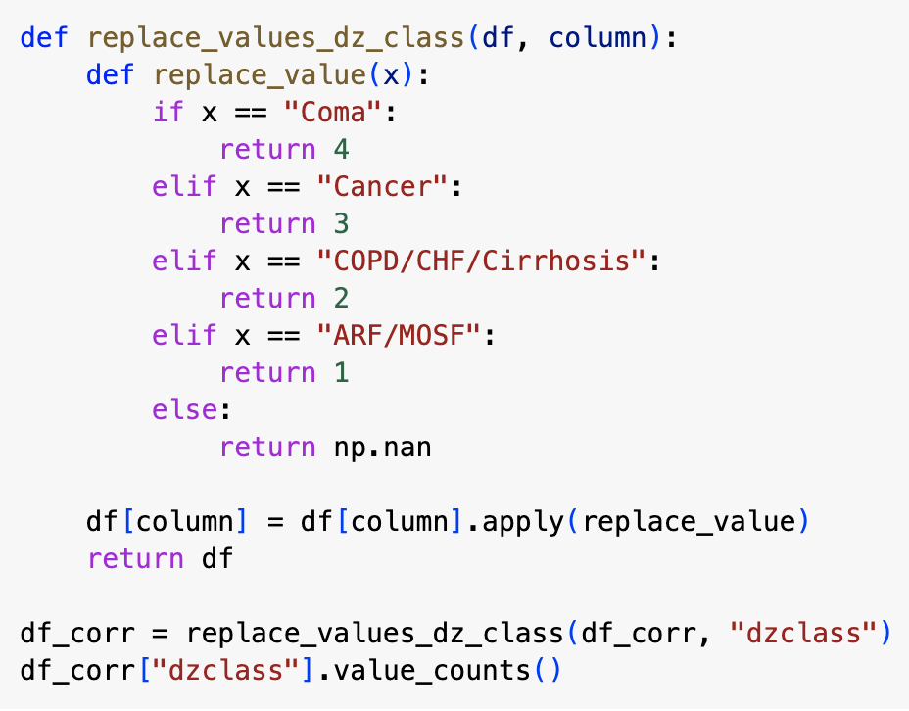
Correlation Analysis
The dataset had values of different data types
All categorical values were changed to numerical

Slide 9
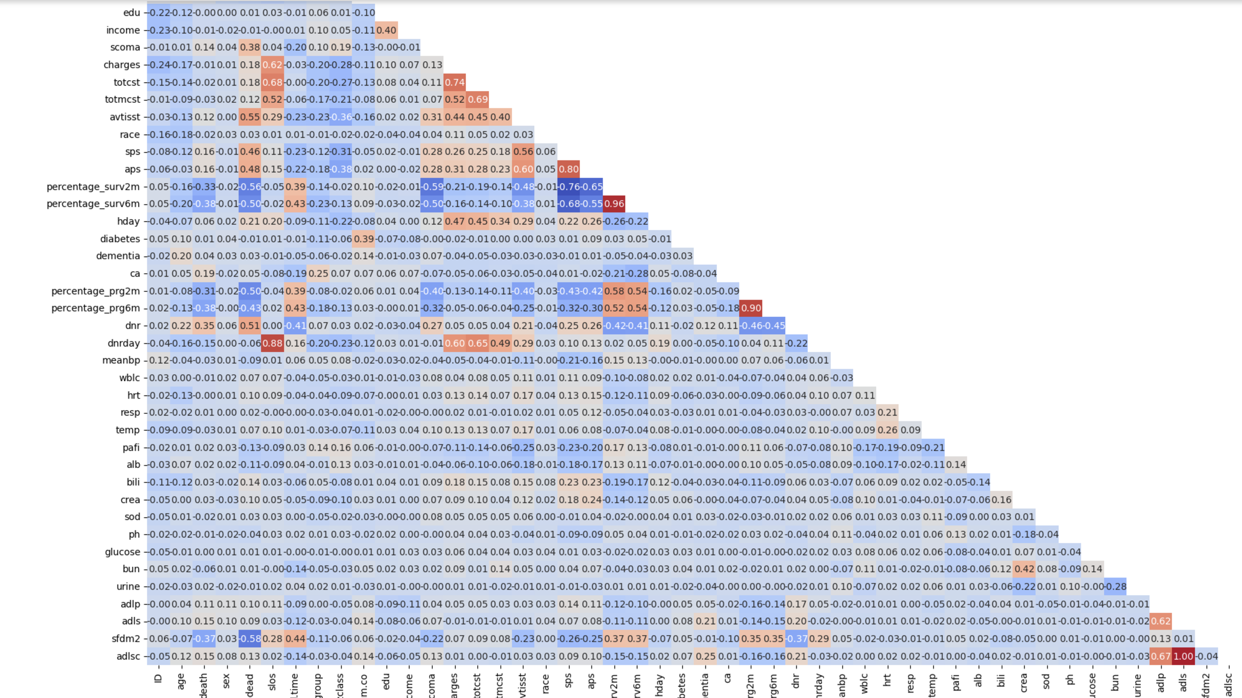
Applying Correlation Matrix

Slide 10
Strongest Correlations
?
1 Imputed Activities of Daily Living Calibrated to Surrogate - Activities of Daily Living filled out by surrogate
0.96 SUPPORT model 6-month survival estimate at day 3 - SUPPORT model 2-month survival estimate at day 3
0.95 Total micro cost - Total ratio of costs to charges
0.9 Physician’s 6-month survival estimate - Physician’s 2-month survival estimate
0.88 Day of DNR order - Days from Study Entry to Discharge
0.87 Total ratio of costs to charges - Hospital charges
0.81 Total micro cost - Hospital charges
0.8 APACHE III day 3 physiology score - SUPPORT physiology score on day 3
0.77 Total ratio of costs to charges - Days from Study Entry to Discharge
0.77 Total micro cost - Days from Study Entry to Discharge
0.73 Day of DNR order - Total ratio of costs to charges
0.72 Day of DNR order - Total micro cost
0.68 Blood urea nitrogen levels measured at day 3 - serum creatinine levels measured at day 3
0.67 Imputed Activities of Daily Living Calibrated to Surrogate - Index of Activities of Daily Living filled out by the patient
0.65 The patient's disease category - The patient's disease sub category
0.62 Day of DNR order - Hospital charges
0.62 Activities of Daily Living filled out by surrogate - Index of Activities of Daily Living filled out by the patient51515
Notes:
(seem predictable)

Slide 11

Visualization
Patient Demographics
Diseases
Mortality and Survival Factors
Medical Expenditure

Slide 12
Research for Patient Demographics
In this section, we investigate the relationship between age, gender, and socioeconomic factors with survival rates.

Slide 13
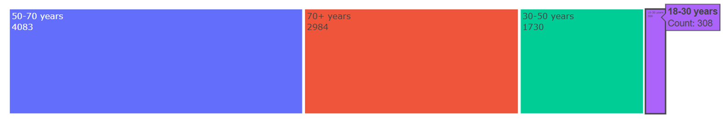
Age Distribution Among All Patients
Individual age values were grouped into 4 categories by using 'if' function. The youngest group was indicated as 18-30 years, followed by 30-50 years, 50-70 years and 70+ years.
Among all age groups of patients, those aged 50-70 years have the highest proportion. This group is followed by patients aged 70+, who represent the second-largest proportion. Patients between 30-50 years come next, showing a moderate contribution to the overall distribution. Finally, the 18-30 age group has the smallest proportion.
This pattern shows that middle-aged and older adults are the most affected or most frequently observed in the study population.

Slide 14
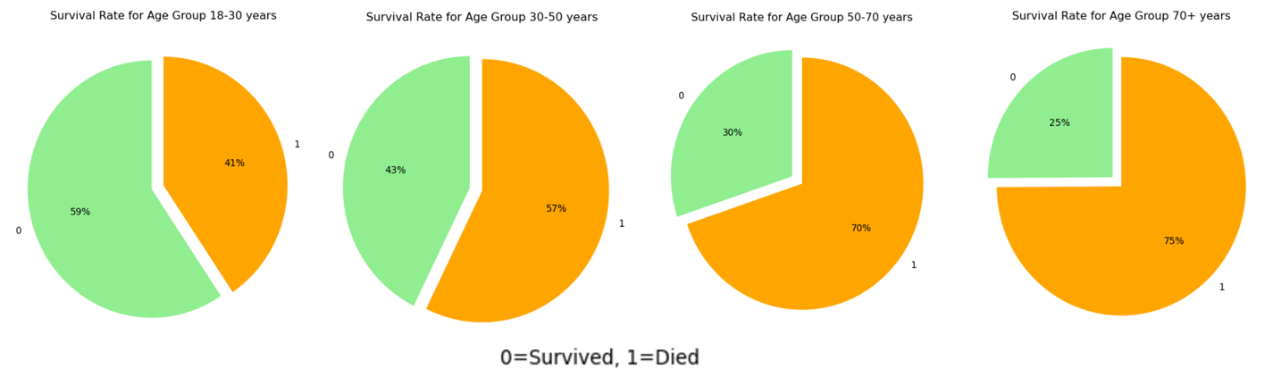
Survival Rate Based on Patients' Age
The investigation of the death rate across each age group suggests that the death rate among individuals aged 70+ is comparatively higher in the study. This is followed by the age groups 50-70 years, 30-50 years, and 18-30 years.

Slide 15
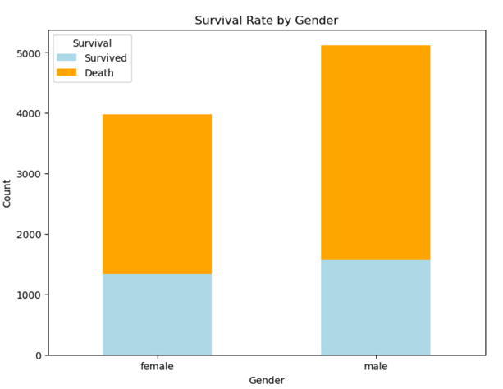
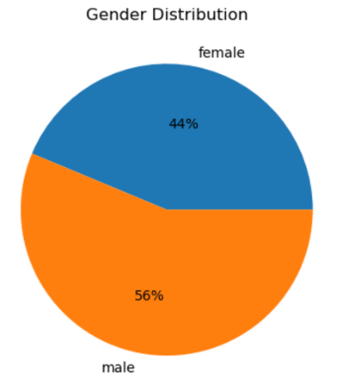
Gender Related Research
•Based on the gender research, the male group has 56% of all patients while the female group has 44%. When investigating whether there is a relationship between gender and mortality rate, no significant difference was observed between genders.

Slide 16
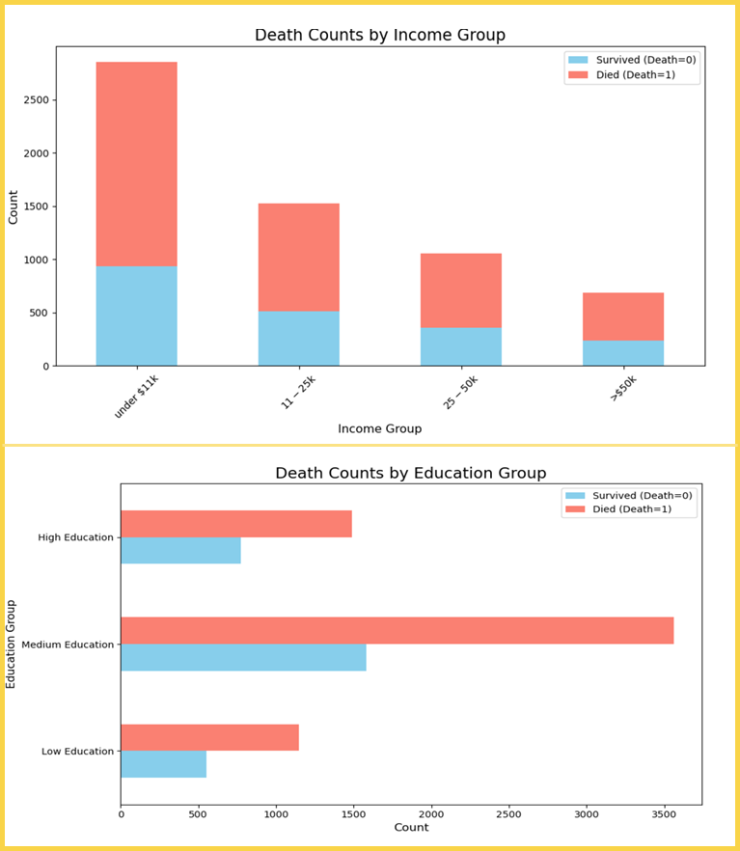
Socioeconomic
Research
•When examining income among patients, it is observed that the proportion of patients with low income is higher, and this proportion decreases inversely with income levels.
•On the other hand, based on the research on education level, a medium level of education is the most common among the patients.

Slide 17
Research for Diseases
In this section, we investigate the relationship between Comorbidities, Physiological Factors, Hospital Mortality Rates and Length of Stay with Diseases.

Slide 18
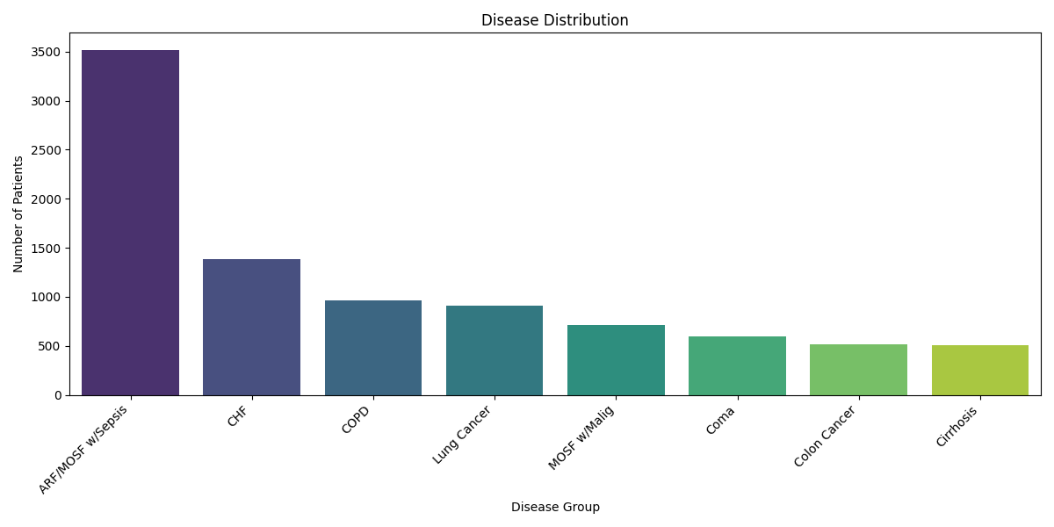
Disease Prevalence
ARF/MOSF with Sepsis is the most prevalent disease with almost 3,500 patients.
Least prevalent diseases include Cirrhosis and Colon Cancer, each with approximately 500 patients.
These results could be due to,
critical nature [frequent hospitalizations or prolonged treatment durations]
rarer conditions or better-managed outpatient cases.
Notes:
We began by examining the prevalence of diseases identifying diseases that significantly contribute to patient volume in the dataset. This bar chart reveals that ARF/MOSF with Sepsis is the most common disease, followed by CHF and COPD. The purpose of this visualization is to provide a clear understanding of which conditions occur most frequently, helping prioritize resource allocation for high-burden diseases. It os also to be noted that this is an uneven distribution and can affect further analyses.

Slide 19
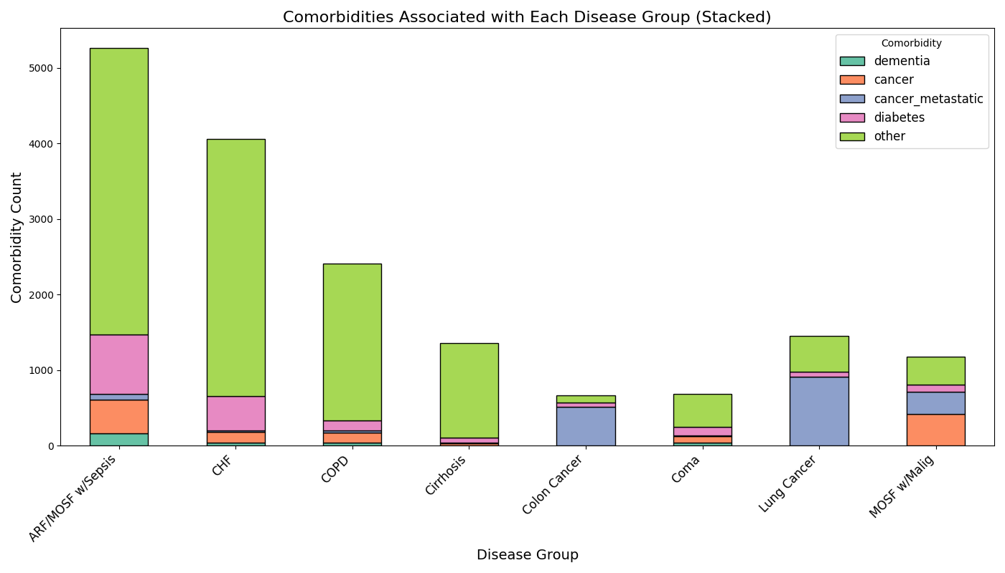
Association of Comorbidities to Diseases
The highest Comorbidity count is associated with ARF/ MOSF w/Sepsis.
Highest Total Burden of Patients with,
Diabetes as Comorbidity – ARF/MOSF w/Sepsis & CHF [cardiovascular and metabolic disorders]
Dementia as Comorbidity - ARF/MOSF w/Sepsis [chronic and critical conditions ]
Cancer as Comorbidity – Lung Cancer, MOSF w/Malig, Colon Cancer [chronic diseases and malignancy-driven systemic effects]
Notes:
Next, we analyzed comorbidities, including dementia, cancer, diabetes, and others, for each disease group by analysing num.co, and primary comorbidity columns and summing up the total comorbidities for each group.
Purpose:
Identifies which comorbidities are more common for specific diseases.
Highlights the total comorbidity burden for each disease group.
Summing shows how comorbidities cluster within a disease group.

Slide 20
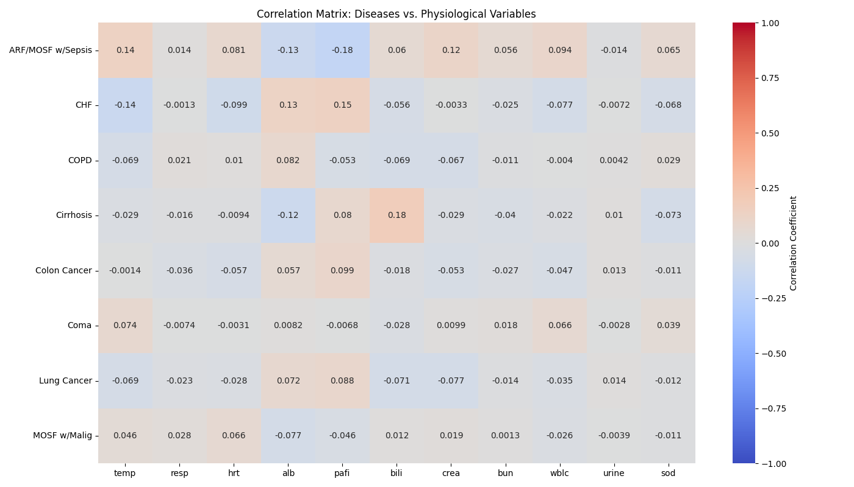
Correlation of Physiological Factors and Diseases
No strong correlations observed between diseases and physiological variables.
The results could be due to,
Aspects of diseases not solely defined by individual physiological variables.
Imputation of Missing values introduce Bias and reduce Variability.
Notes:
Next, we look into the correlations between diseases and laboratory measurements like creatinine, bilirubin, and PAFI. The purpose of this visualization was to identify physiological patterns linked to specific diseases, aiding diagnostic and monitoring processes. However, as you can see there are no Strong correlations [[[[such as elevated creatinine in ARF/MOSF with Sepsis, highlight key diagnostic markers. ] Reasons for this is Diseases are multifaceted and not solely defined by individual physiological variables. relationships between diseases and physiological measurements could be nonlinear or influenced by multiple interacting factors.

Slide 21
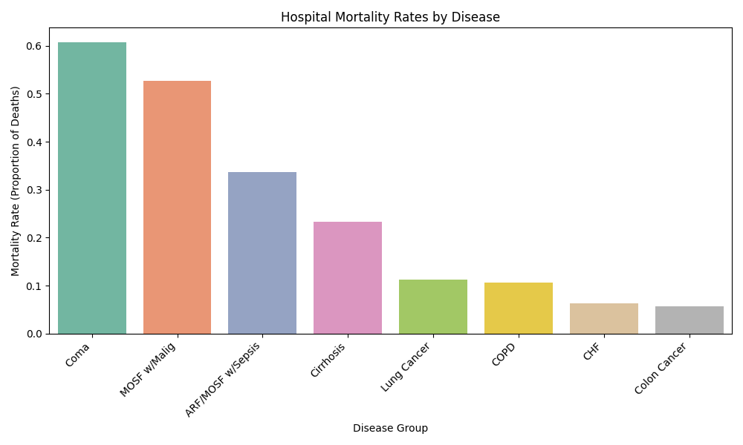
Diseases by Hospital Mortality Rates
Highest Death rate in the hospital was recorded among patients who were in Coma.
Lowest Death Rate in hospital was for Colon Cancer.
These results could be due to,
Limited recovery potential/severe physiological derangements
Treatment complexity
Surgical and medical management effectivity
Notes:
Next, we analyzed mortality rates by disease within the hospital context. The chart shows that Coma and MOSF with Malignancy have the highest death rates. The purpose here was highlighting immediate care and treatment effectiveness. It helps identify areas for acute care improvement and resource allocation without the influence of post-hospital factors..

Slide 22
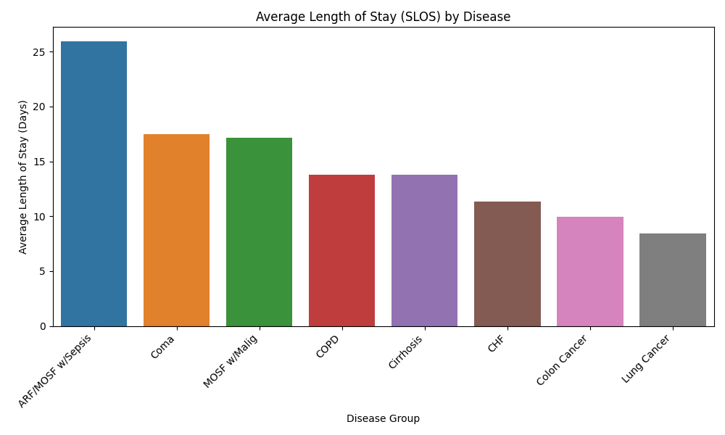
Diseases by Hospital Length of Stay
Patients who stayed in the Hospital the most were patients with ARF/MOSF w/Sepsis
Patients who stayed in the hospital the least were patients with Lung Cancer.
These results could be due to,
Extended critical care and recovery time
Focused interventions or advanced disease progression
Notes:
This chart shows the average length of hospital stay (SLOS) for each disease group. Longest: ARF/MOSF w/Sepsis → associated with complex critical care Shortest: Lung Cancer → may reflect rapid disease progression or limited intervention scope. This insight supports hospital resource planning, particularly for bed and staff allocation.

Slide 23

Mortality/Survival Factors

Slide 24
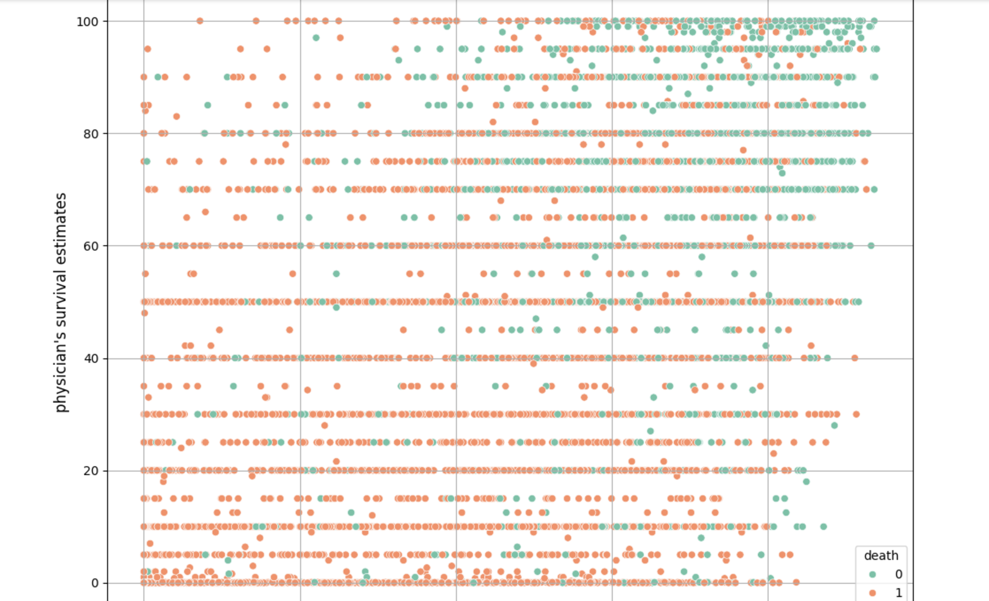
Comparison of physician's survival estimates and predictions made by SUPPORT model in terms of actual deaths
Physician's 6 months survival estimates are slightly less precise.

Slide 25
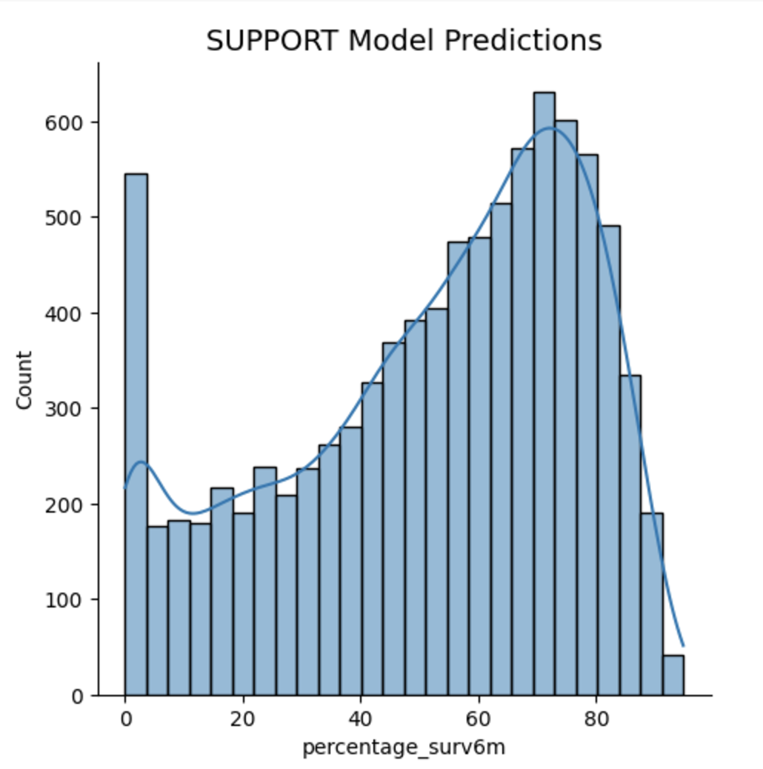
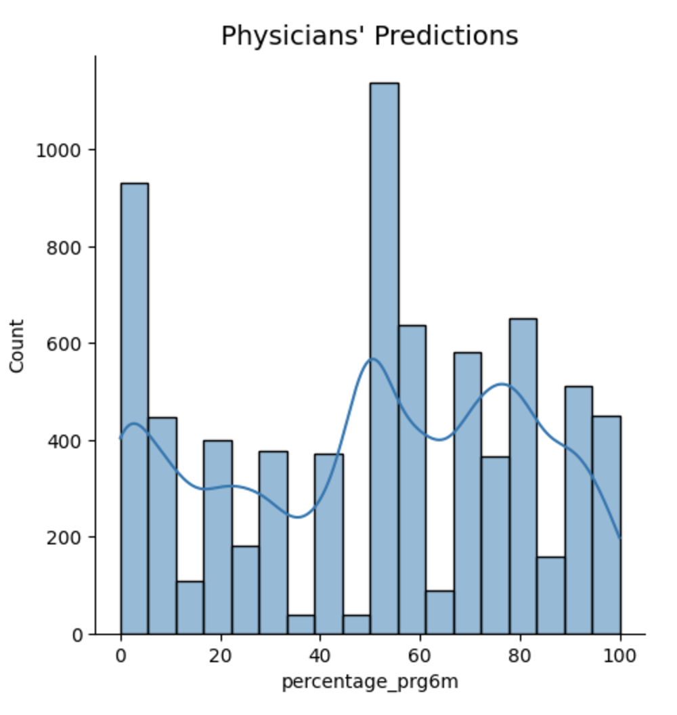
Curves of Physician's Survival Estimates and Predictions by SUPPORT Model
SUPPORT Model Predictions
Physician's Survival Estimates
SUPPORT models 6 months survival predictions are more consistent. Predictions made by SUPPORT model give higher survival estimates than those made by physicians. Highest counts of estimates given by SUPPORT model are 70% and by physicians are 50%. Second highest is 0% for the both.
Notes:
SUPPORT model predictions - left-skewed (negative distribution) with high counts for zeroes.
Physician's survival estimates - high counts for zeroes and 50%.

Slide 26
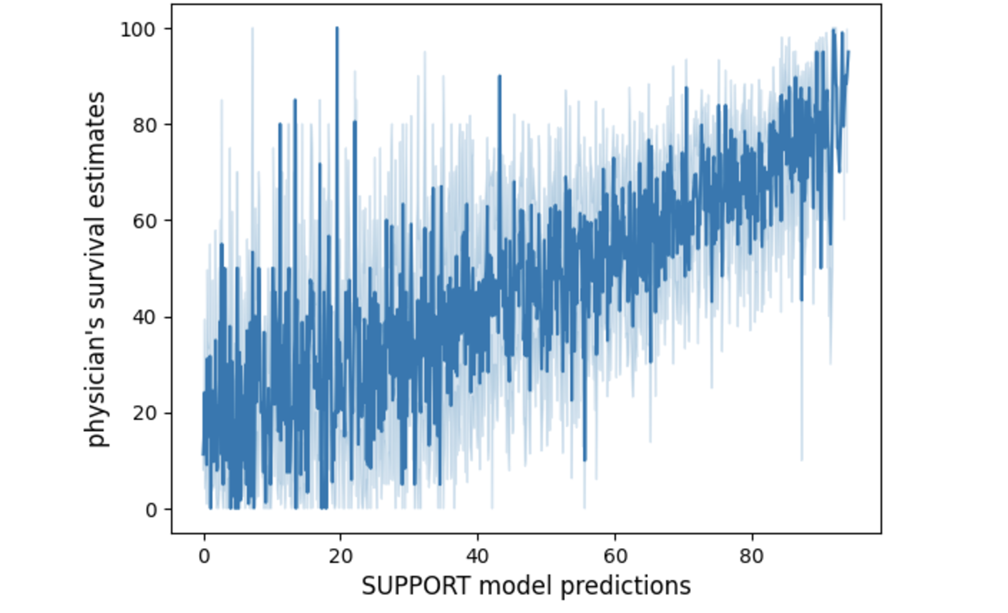
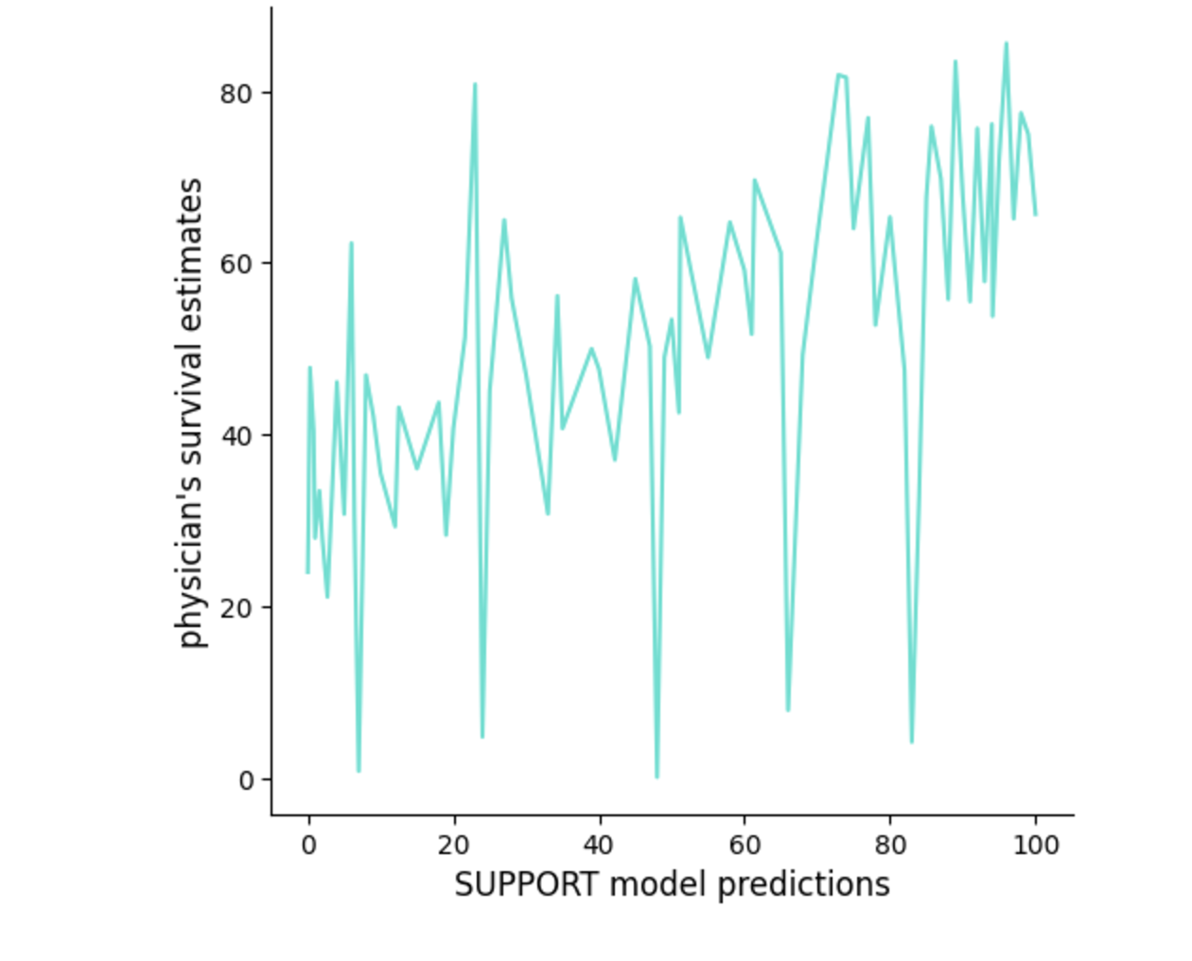
Compare Physician's Survival Estimates and Predictions by SUPPORT Model
SUPPORT Model Predictions
Physician's Survival Estimates
The main differences are observed at 20% vs 80% and 50% and 60%, which could result from physicians' rounding percentage. Further information on how the estimates and predictions are given is necessary.
Notes:
Compare physician's survival estimates and predictions made by SUPPORT model - big difference at 20% vs 80%, 50% and 60%.

Slide 27
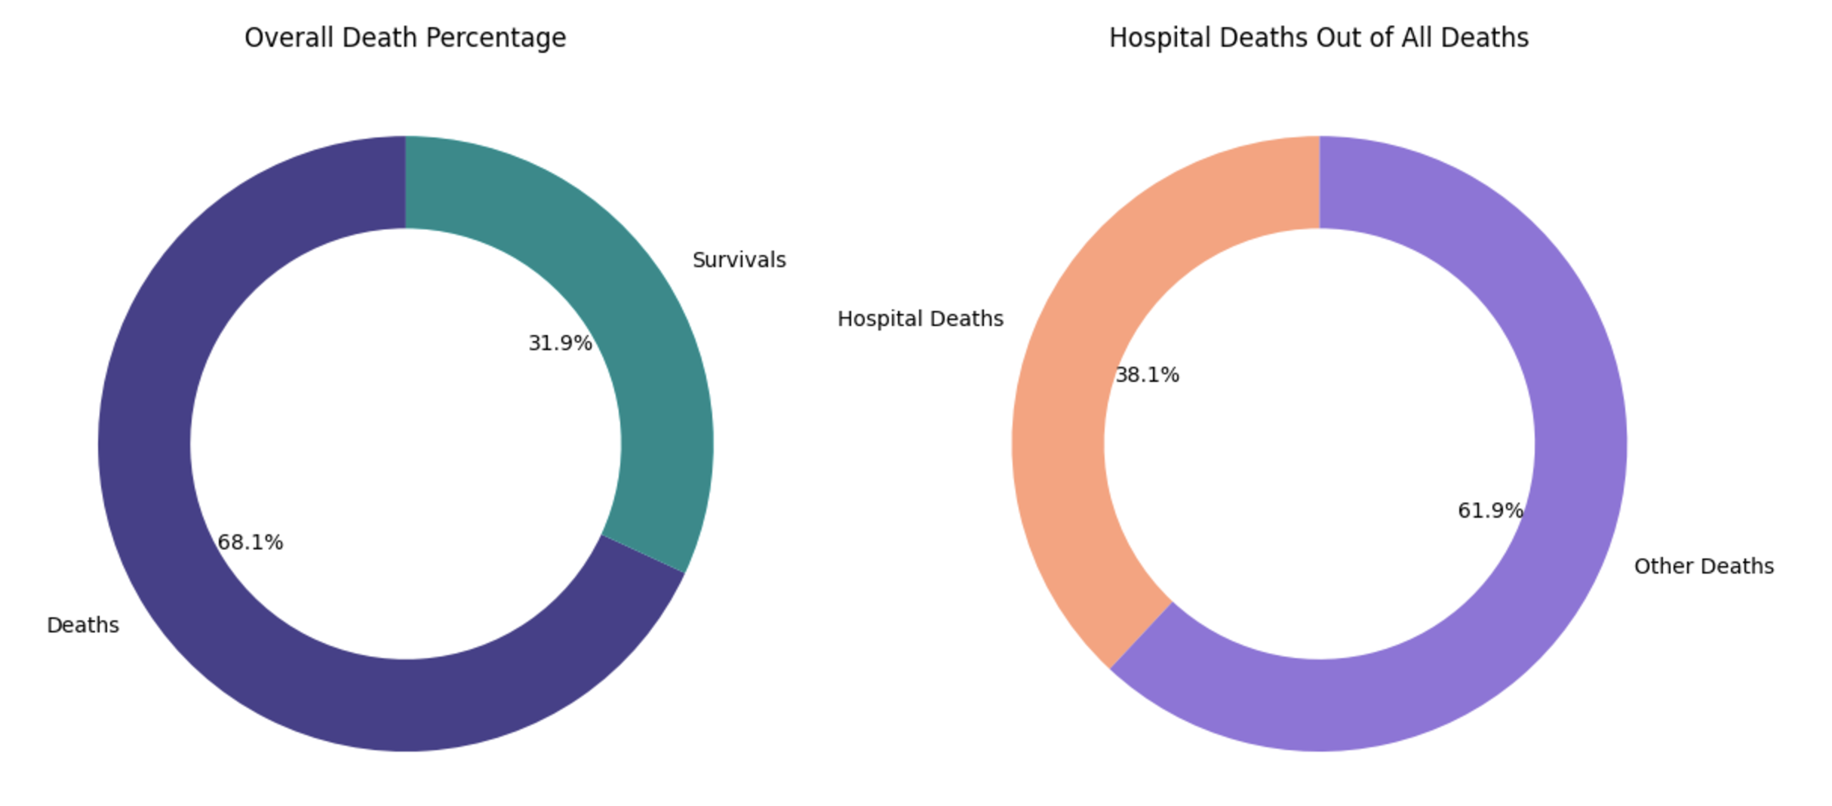
What Percentage of Deaths Were Deaths in Hospital?
Deaths in hospital are relatively low, which can potentially mean higher chances of survival if a patient is in hospital.

Slide 28
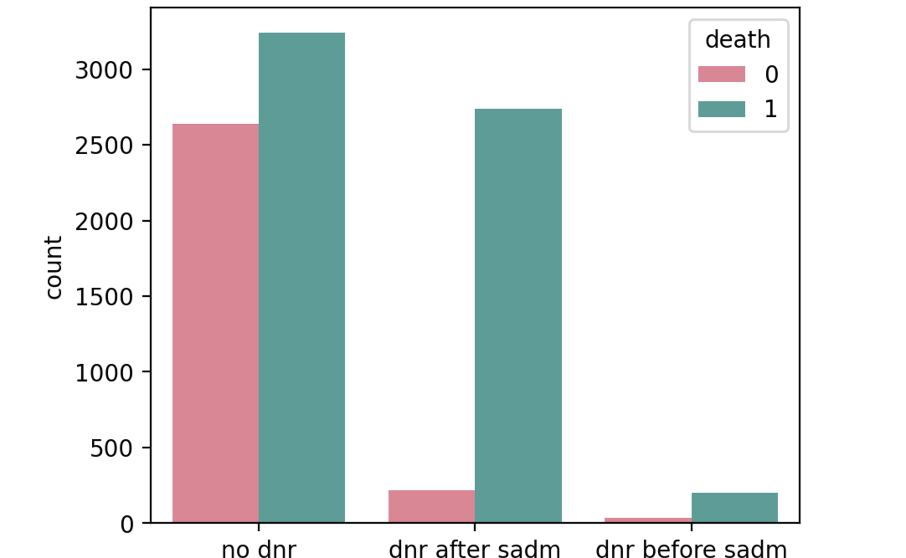
Potential Correlation Between the Do Not Resuscitate Order and Mortality
Mortality is significantly higher for patients who gave the Do Not Resuscitate Order after first admission compared to those who had the Do Not Resuscitate Order before first admission or did not have it at all.
Notes:
DNR after first admission is significantly higher in deaths

Slide 29
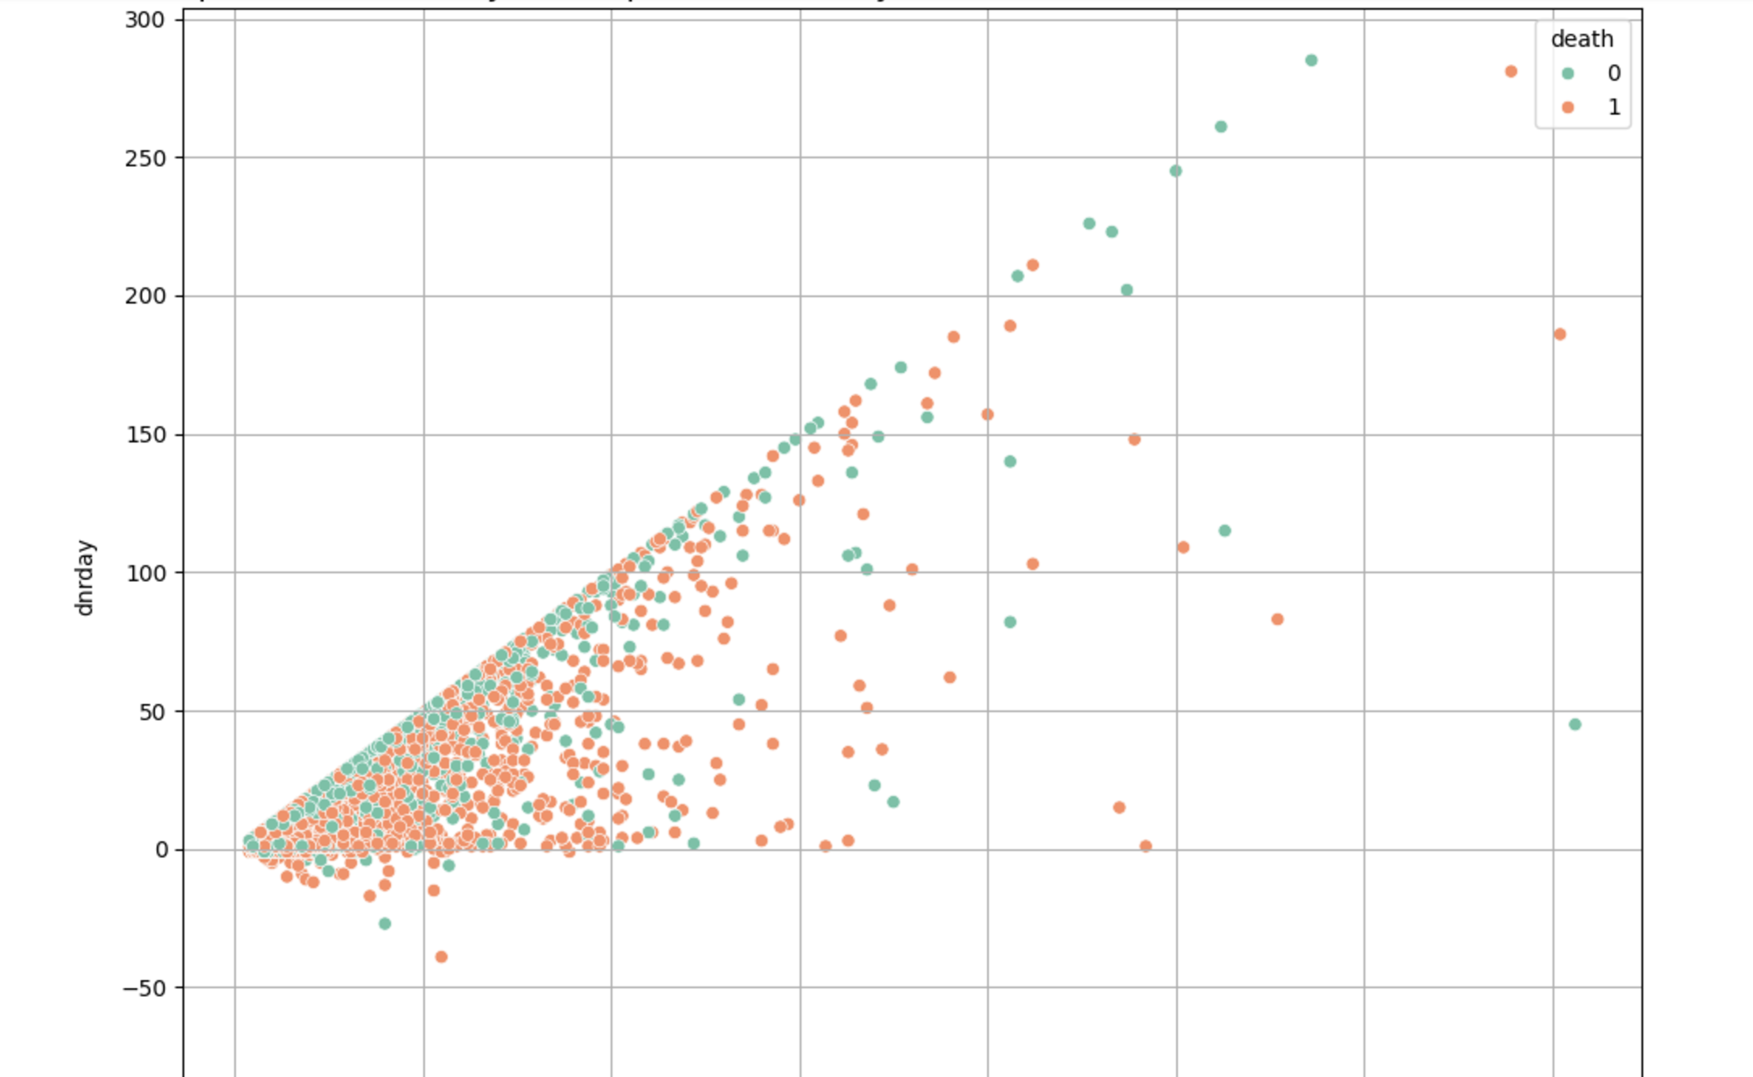
Comparison of Total Days in Hospital and the Day of the Do Not Resuscitate Order in Terms of Deaths
There a connection between the day of Do Not Resuscitate order and length of stay in hospital but no correlation between them in the number of deaths.

Slide 30
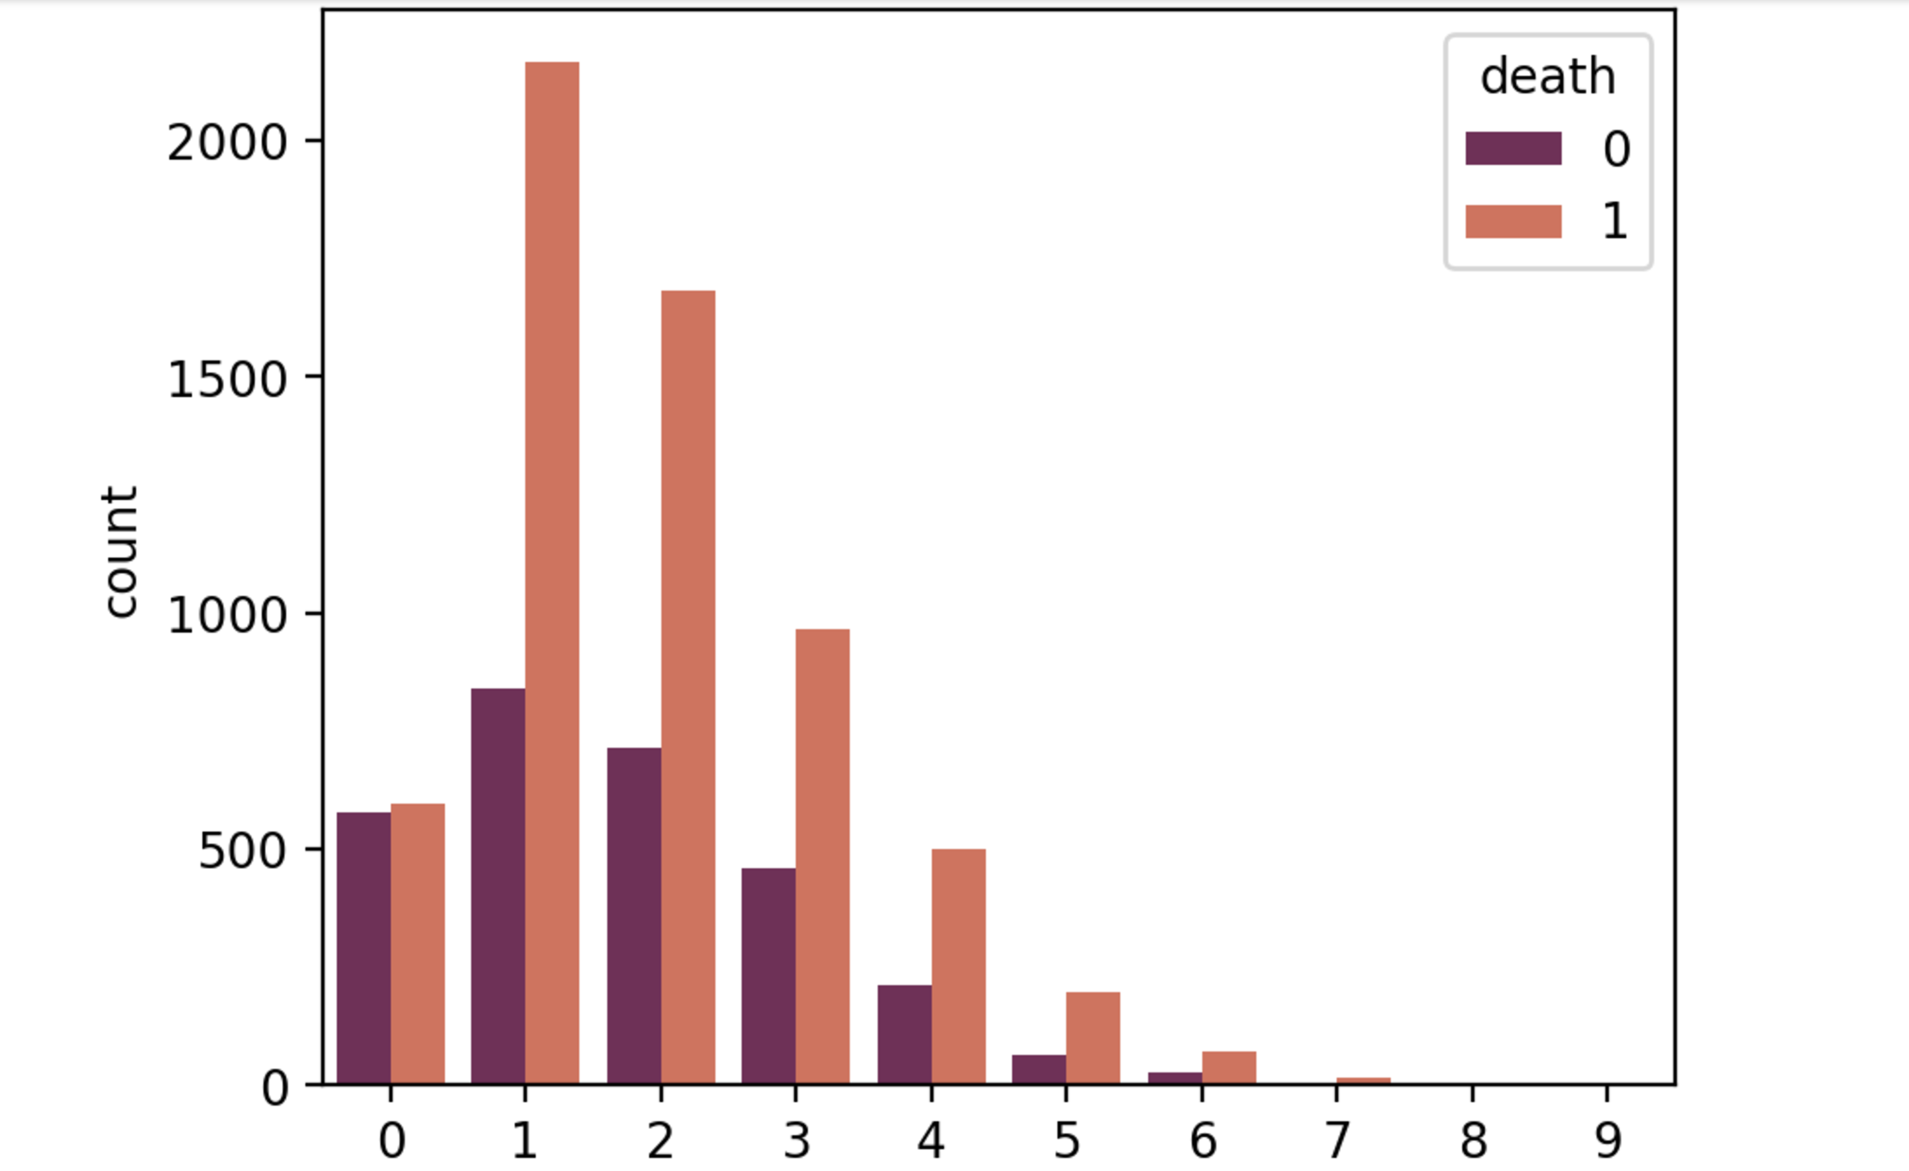
Potential Correlation Between Number of Comorbidities and Mortality
The number of comorbidities does not seem to be linked to mortality, with the highest mortality with 1 and 2 comorbidities and almost 50% chance of survival with zero comorbidities.
Notes:
Surprisingly no increase in deaths with increase in number of comorbidities

Slide 31
Are the hospital charges different for people from different races?
Purpose:
To find out whether people from different races were charged differently
If ‘Yes’ then how the difference in the charges are related to mainstream diseases

Slide 32
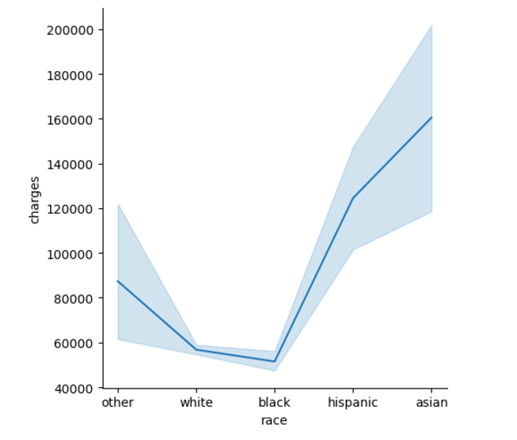
Hospital Charges charged to different races
The plot evidently shows the difference between the charges incurred to people from different races
People belonging to the white and black race have been charged less as compared to other races
People from the Asian race have been charged the most as determined from the available data
The results can be due to different reasons:
People from different races coming to the hospital for different needs
People from different races are more prone to the diseases than others

Slide 33
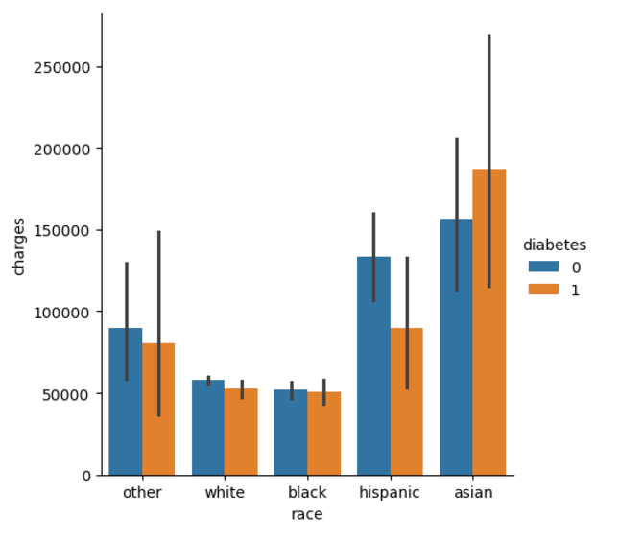
Hospital charges to different races with the comparison of the diabetes
The plot shows that the Asians with diabetes are the people who have incurred the most charges from the hospital
Other races, as compared, are charged less when differentiated based on diabetes
This suggests that the hospital has give more attention to the Asian people with diabetes
Meanwhile people from other races do not have much difference when the data is segregated in terms of diabetes
People belonging to the Hispanic race shows a different trend. This can probably mean that their illness is less affected due to diabetes

Slide 34
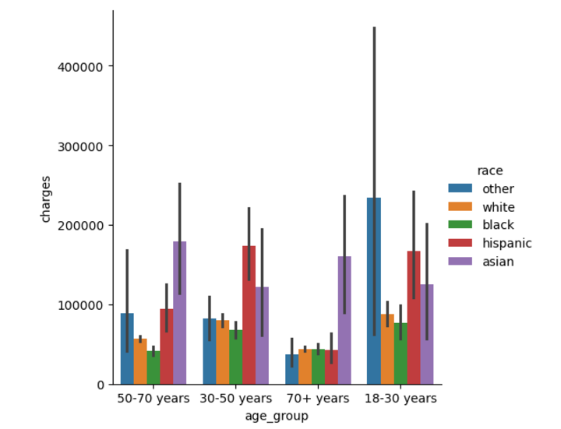
Hospital charges incurred to different age groups from different races
We wanted to see the hospital charges differing with different age group in different races.
The plot evidently shows that the age group 18-30 years and 30-50 years old has been charged by the hospital more
The age group 70+ years has been charged the least as collective
This plot can suggest that the difference in charges with age and race can be due to different reasons:
The living habits of people from different races and ages
The genes and their body development
This plot reflects how the hospitals must be careful with people from different ages and races

Slide 35
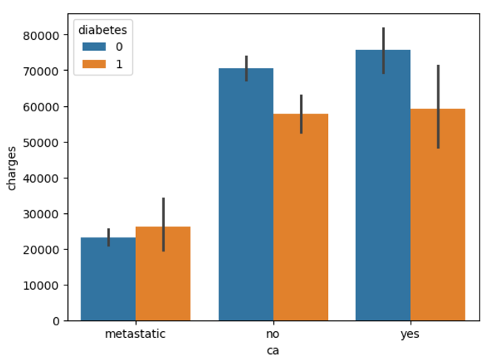
Hospital charges relation to cancer segregated with diabetes
Assumption: People with diabetes and cancer would have incurred the most hospital charges
The plot shows that the patients who had metastatic cancer were charged less than those who either had cancer or no cancer at all
People with cancer who did not have diabetes were charged more than those who had diabetes
Non-diabetic patients who did not have cancer were charged less than non-diabetic patients with cancer

Slide 36

Recommendations
It is significant that mortality rate is related to age. We can conclude that the elderly group should be more cautious, and additional measures should be taken for their well-being.
Targeted preventions can be identified by observing specific comorbidities that may dominate certain disease groups.
6 months survival estimates made by SUPPORT model are more precise and even. Further information on how the estimates and predictions are given is necessary.
Staying in hospital can potentially mean higher chances of survival.
Further research is necessary on why mortality is significantly higher for patients who gave the Do Not Resuscitate Order after first admission.

Slide 37

Challenges
Due to the lack of domain knowledge, some of the missing values couldn't be imputed.
Decision for keeping, transforming, or removing outliers is highly dependent on domain knowledge. Some of the outliers transformed or removed based on the insight from the data set. However, most of the outliers were left unchanged to prevent the loss of any critical information.
Distribution of uneven amount of patient subgroup data(Ex: Different Disease Groups, Patient Demographics) makes it difficult and limits the conclusions we can draw out of them.

Slide 38

Q&A

Slide 39

Thank you for your attention from Group 1!
aka Dream Team

